Slide 1
CS471 ASST1
Thread Synchronization

Slide 2
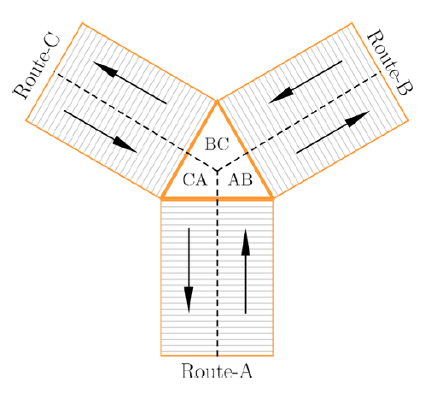
Synchronization Problem
Traffic management in Podunk
Two types of vehicles: Cars and Trucks
Cars have higher priorities than Trucks
Each vehicle is a thread trying to cross the intersection
What is the “shared resource” here?

Slide 3
Podunk Traffic Management [50 points]
Model the intersection as “shared resources”, protected by “locks”
A vehicle (thread) need to acquire the proper lock(s) in order to enter the intersection
Two vehicles entering the same portion of the intersection at the same time is an accident
Locks are supposed to prevent that
Deadlocks can happen!
Your solution must prevent deadlocks
Imagine a deadlock situation (exercise.txt question #2)
You can only use the “locks” that you have implemented
“Busy waiting” is not allowed

Slide 4
Podunk Traffic Management (Cont.)
Each vehicle should print a message as it approaches, enters, and leaves the intersection indicating the vehicle number, vehicle type (car or truck), approach direction and destination direction.
% Car 1 from Route A to turn RIGHT to Route B APPROACHES the intersection
% Truck 5 from Route B to turn LEFT to Route A ENTERED BC
% Car 7 from Route C to turn RIGHT to Route A LEFT CA
No two vehicles can be at the same portion of the intersection at any given time.
% Car 1 from Route B to turn LEFT to Route A ENTERED BC
% Car 2 from Route B to turn RIGHT to Route C ENTERED BC
% Car 1 from Route B to turn LEFT to Route A LEFT BC
% ...

Slide 5

Podunk Traffic Management (Cont.)
A car should never be delayed by a truck but is it fine if a truck suffers starvation.
Your solution must improve traffic flow, and should maximize utilization of the intersection
No vehicles should be kept waiting if not necessary
Tracks should not wait for “future” cars
Avoid all unnecessary delays.
For example, in the figure on the right, car 1 should not
unnecessarily delay the entry of car 2. Because their paths are
not interfere with each other. They can proceed parallelly.
This is just an example: think about whether your solution
Imposes an unnecessary delay or not in other ways.
2
1

Slide 6
Podunk Traffic Management Implementation
You need to modify just one file
~/os161/os161-1.11/kern/asst1/stoplight.c
createvehicles() creates 20 vehicles (threads), and passes them to approachintersection() function
Each thread calls approachintersection() simultaneously
approachintersection() assigns a random incoming direction, a turn and the vehicle type
Each vehicle should print a message for “approach”, “enter” and “leave” the intersection, containing the vehicle number, type, approach direction and destination
Clearly and unambiguously printing those messages is part of the project (if necessary, use locks).
Use locks to ensure messages are printed in the way you designed

Slide 7
What to Submit
For part 1 (Deadline: Thursday, October 14), create a directory ‘asst1-part1’, containing:
code-reading.txt
progress-report.txt
For part 2 (Deadline: Thursday, October 28), create a directory ‘asst1-part2’, containing:
asst1.diff
sys161.conf
exercises.txt
Your entire source tree (the os161-1.11 directory), compressed
Printing vehicle messages properly is very important to identify accidents
You will not receive substantial score if your messages are ambiguous, i.e., if they do not clearly specify what is going on in the intersection
You cannot use “semaphores” nor “busy waiting” for this project

